Slide 1
shift
0
ins
/
>
▶
<
▲
◀
▼
목적
Enjoy your stylish business and campus life with BIZCAM
ctrl
space

Slide 2
shift
0
ins
/
>
▶
<
▲
◀
▼
ERD
Enjoy your stylish business and campus life with BIZCAM
ctrl
space

Slide 3
shift
0
ins
/
>
▶
<
▲
◀
▼
프로토타입
Enjoy your stylish business and campus life with BIZCAM
ctrl
space

Slide 4
shift
0
ins
/
>
▶
<
▲
◀
▼
일정
Enjoy your stylish business and campus life with BIZCAM
ctrl
space

Slide 5
shift
0
ins
/
>
▶
<
▲
◀
▼
작업환경
Enjoy your stylish business and campus life with BIZCAM
ctrl
space

Slide 6
shift
0
ins
/
>
▶
<
▲
◀
▼
IDE
Enjoy your stylish business and campus life with BIZCAM
ctrl
space

Slide 7

나는야개발자 조
마음만은 top개발자
김도우 이도영 이승연 임현진

Slide 8
shift
0
ins
/
>
▶
<
▲
◀
▼
차례
Enjoy your stylish business and campus life with BIZCAM
ctrl
space
space
목적
space
ERD
space
프로토타입
space
계획

Slide 9
shift
0
ins
/
>
▶
<
▲
◀
▼
목적
Enjoy your stylish business and campus life with BIZCAM
ctrl
space
“장인은 도구를 탓하지 않는다”
쉽고
편리하고
건강하게

Slide 10
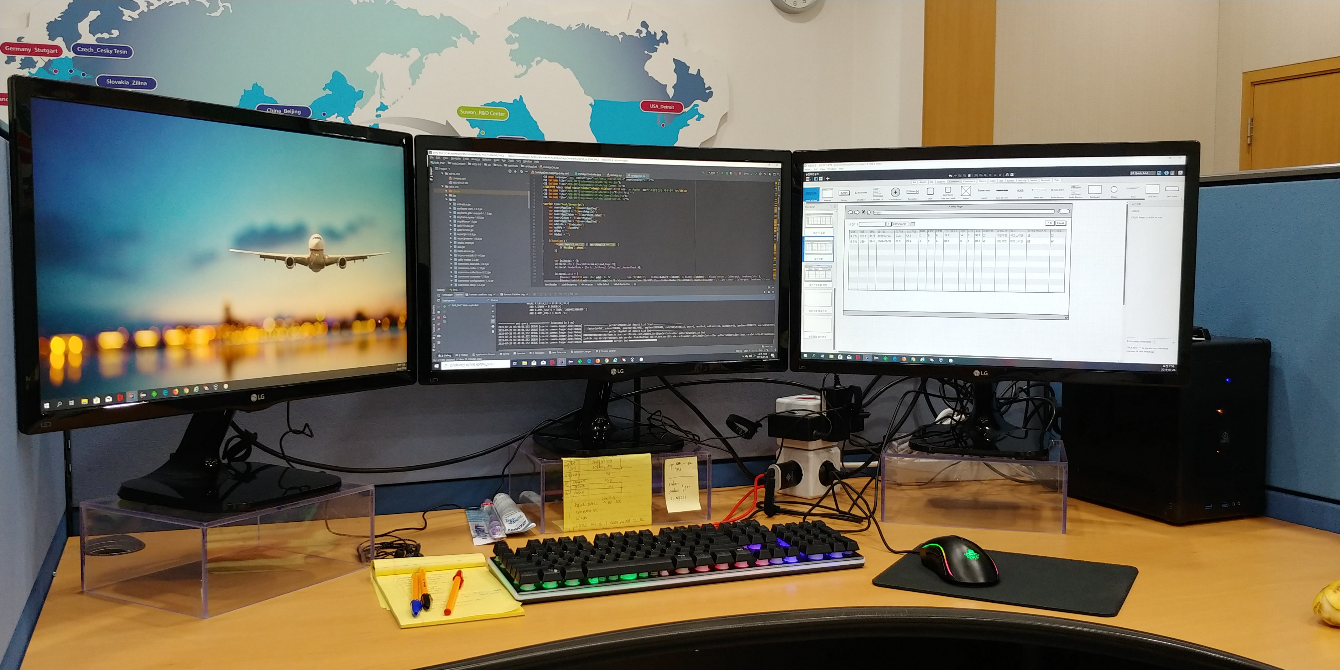


shift
0
ins
/
>
▶
<
▲
◀
▼
목적
Enjoy your stylish business and campus life with BIZCAM
ctrl
space

Slide 11
shift
0
ins
/
>
▶
<
▲
◀
▼
ERD
Enjoy your stylish business and campus life with BIZCAM
ctrl
space

Slide 12
shift
0
ins
/
>
▶
<
▲
◀
▼
프로토타입
Enjoy your stylish business and campus life with BIZCAM
ctrl
space

Slide 13

shift
0
ins
/
>
▶
<
▲
◀
▼
일정
Enjoy your stylish business and campus life with BIZCAM
ctrl
space
5/9 | 10 | 11 | 12 | 13 | 14 | 15
16 | 17 | 18 | 19 | 20 | 21 | 22
23 | 24 | 25 | 26 | 27 | 28 | 29
5/11~5/12설계
휴일
5/12~5/13 R&D
휴일
개발작업 5/14~5/25
휴일
휴일
발표
휴일
테스트 및 발표준비 5/25~5/27

Slide 14











shift
0
ins
/
>
▶
<
▲
◀
개발환경
Enjoy your stylish business and campus life with BIZCAM
ctrl
▼
space
Programming Language
IDE
Mark-up Language
DB
Framework
협업툴
Plugin

Slide 15
경청해주셔서
감사합니다.

